Slide 1
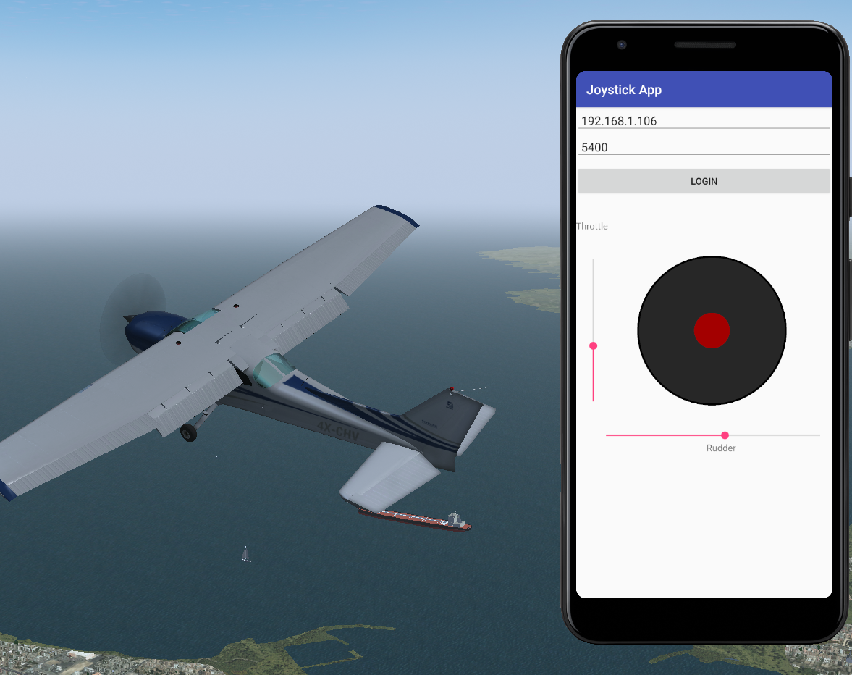
Joystick app
Sapir Kroitoro

Slide 2
ABOUT:
My name is Sapir Kroitoro. I’m a Computer Science student in Bar-Ilan University and currently taking the “Advanced Programming 2” (89211) course.
As part of the course, we have a different exercises to improve our skills in Object Oriented Design and Object Oriented Programming. we develop desktop app ,web app and android app.
Here I’m going to present my android app-remote control joystick

Slide 3
Introduction
The app design for android and allow you to remotely control the plane in FlightGear Simulator.
The app contain client side which connect Flight Gear server and send commands to set the plane controls: aileron, elevator , rudder and throttle.
The flight simulator server listen to local server ,given by the client. Any command the client send result changed in the controls accordingly.

Slide 4
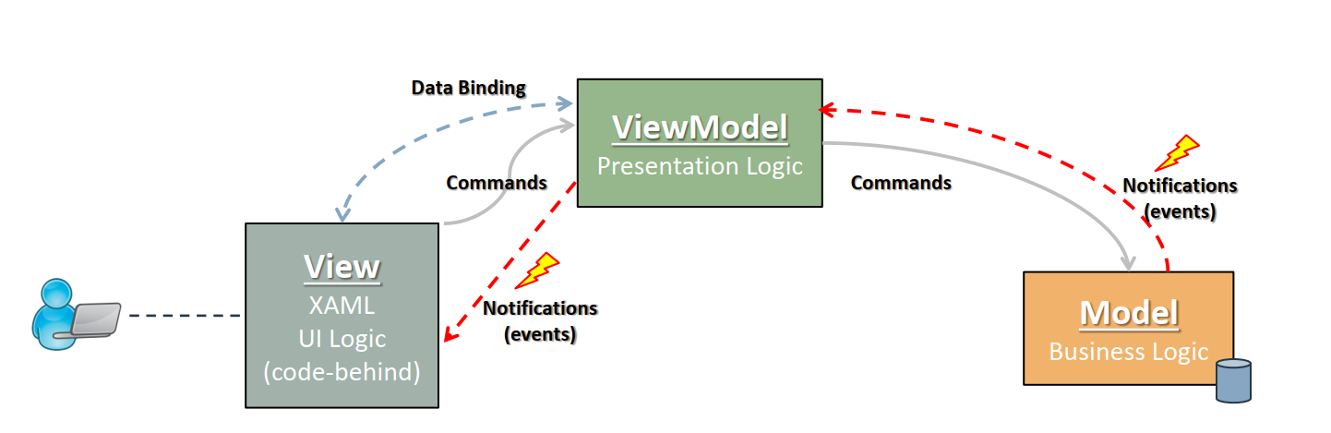
The degin pattern
I used Model–view–viewmodel )MVVM( as design pattern to the app.
The model contain the client side and run in different thread than the main activity.I chose to implement the client side as Thread Pool with one thread.
The View is user interface which handles the canvas drawings and touch events. It conatian the joystick(for aileron and elevator) ,two seek bar (for throttle and rudder) and login(IP and port to for the server). In addition, the view apply dependency injection with Strategy Pattern.
The viewmodel recive the data from the view and send it to Flight Gear server by using the client side in the Model.

Slide 5
Class review -Model
The model contain 4 class: Client, clientToServer , ConnectStatus and MyThreadPool.
Client – The class has the basic information of the client:ip,port. Each one has getter and setter. The getter and setter is binding to the view’s text boxes where the user write his ip and port.
clientToServer -client side. Responsible for the connection with the flight gear server. each function has it own responsibility. For example, there is one function to send the aileron and elevator values ,and another function to send the throttle information.

Slide 6
Class review -Model
ConnectStatus - has the connect status to the sever.
MyThreadPool - A thread pool using the runnable interface. The thread pool has one thread to run different tasks in order to communicate with the server. each task handle different action with the server,(the action is in the task name):connect ,disconnect ,send aileron and the elevator values ,send throttle value and send rudder value.

Slide 7
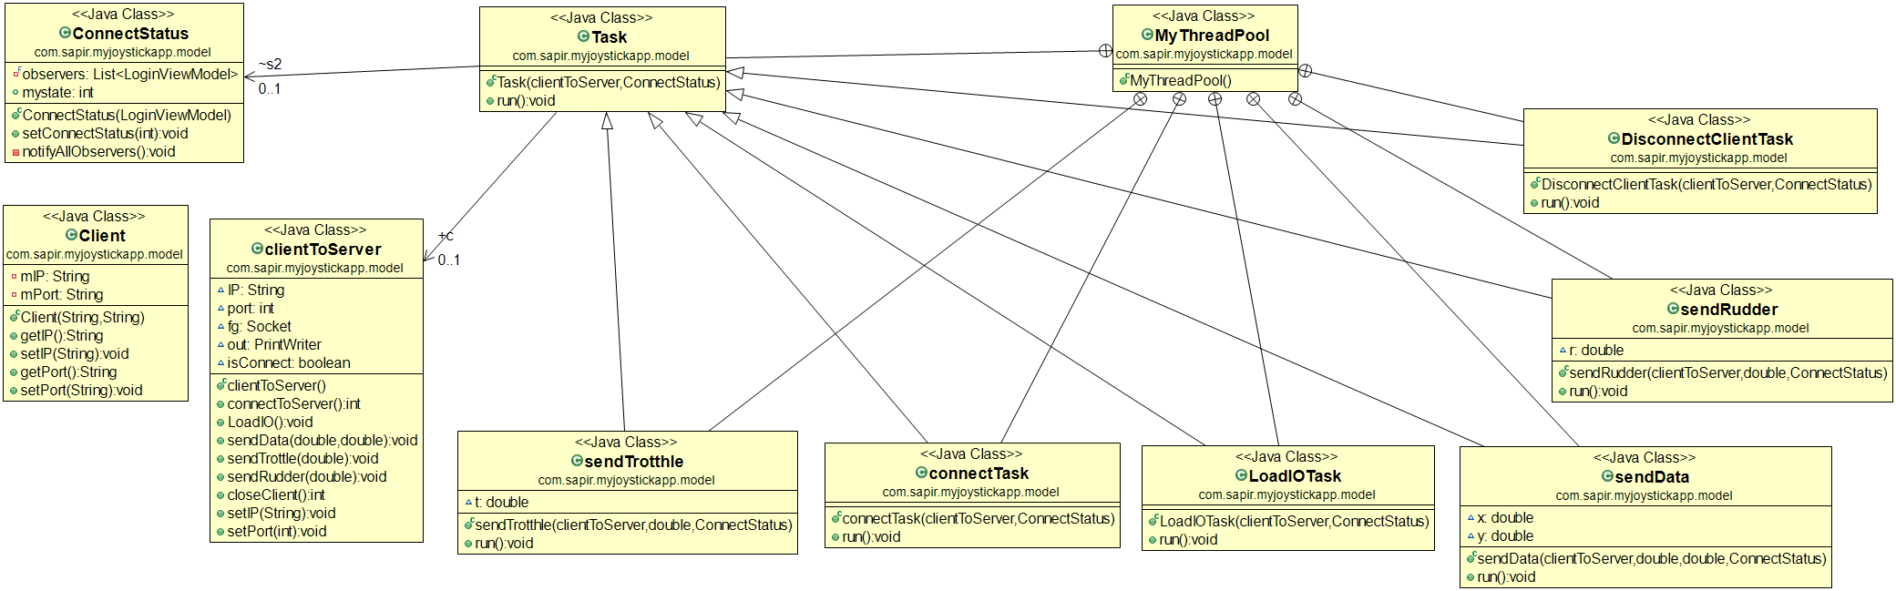
Model UML diagram

Slide 8
Class review - The View
The view contain 2 class Main Activity and the joystick.
MainActivity - responsible to create all the elements in the view. In this class I use the decoupling principle to send a data from the view to the viewmodel: I create a listener to the joystick movement using lambda function.
(ADD THE SEEK BAR)
MynewJoystick –handle the drawing of the joystick and the touch event. In each touch, the class convert the movement to values of the elevator and aileron. I compute the distance between the start position of the joystick and the current position.( The distance in X axis is the elevator value and the distance in Y axis is the aileron value). The value convert to match the right limit for the aileron and elevator.
I used databinding to connect between the View and the ViewModel.

Slide 9
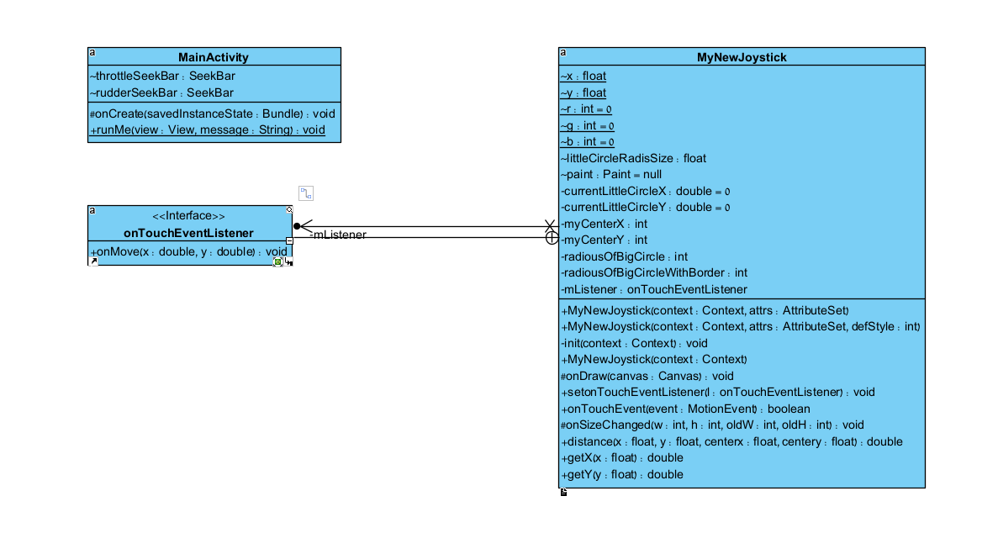
The View UML digarm

Slide 10
Class review - The View MODEL
The View Model has one class LoginViewModel.
LoginViewModel – Responsible for sending information from the view to the server. each model’s class is a private member of the class. There is getter and setter for the IP and port and function for the “login” button (start when the button is clicked). Further more , the class contain functions communicate the server using the model’s functions. For example ,I implement Observer design pattern to inform the user on any change in the connect status (connect to the server or disconnect).the model view set a toast message with the information and notify the view.
The ViewModel is binding to the view and communicate with the server using the models class

Slide 11
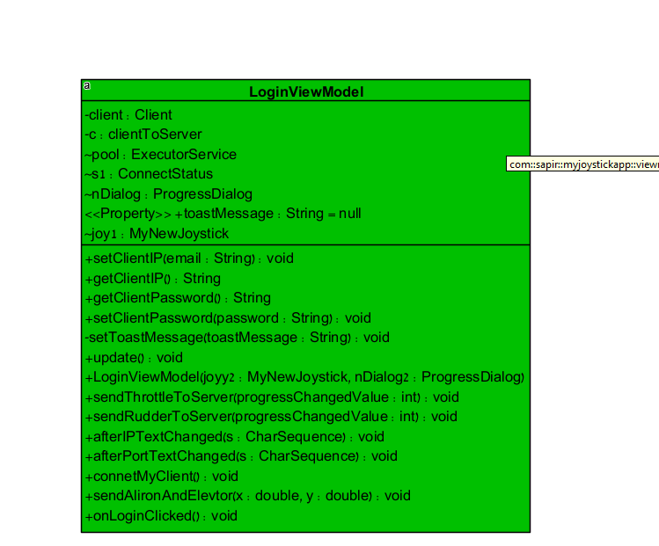

The View model UML diagram

Slide 12

Class diagram
A full class diagram:
ModelView
View
Model

Slide 13
ViewModel:
LoginViewModel - has the joystick and client info. this class responsible for sending iformation to the server from the view like ip,port alieron etc.

Slide 14
Introduction
UML diagrm:
ModelView
View
Model

Slide 15
ModelView
View
Model

Slide 16
View:
MainActivity - responsible for loading all the elements in the view.instilizaing a lodaing dialop and lister to the joystick movement.In this class I use the decoupling pronciple to send a data from the view to the viewmodel.(the lambda funtion for the joyustick listner)
MynewJoystick -the class contain the code for drawing the joystick and compute the movement values of the elevtor and alieron.
I used databinding to connect between the View and the View model.

Slide 17
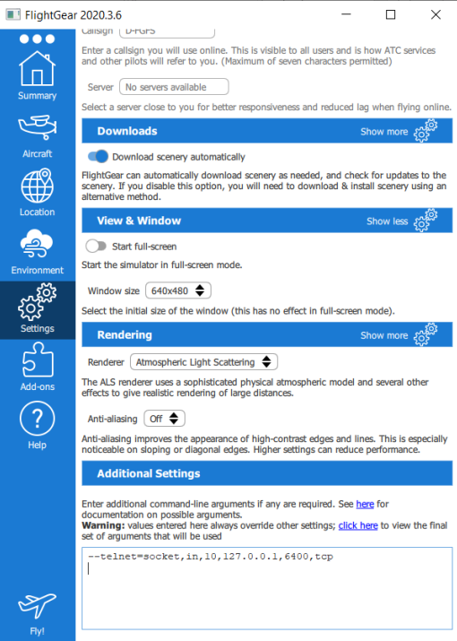
HOW TO USE:
download flight gear and install it. put the following commend in setting->additional setting:
--telnet=socket,in,10,127.0.0.1,5400,tcp

Slide 18
HOW TO USE:
For phone: download myjoystickapp.apk and install it on your phone.(make sure install from Unknown sources is allowed)
For PC: clone the repo and make sure you have phone emulator in your PC

Slide 19
HOW TO USE:
Open the app and write your PC IP and port "5400" then press login.
Note: you can get your PC IP from the cmd. open the cmd and write the commend: ipconfig Your pc IP is the address in IPV4.

Slide 20
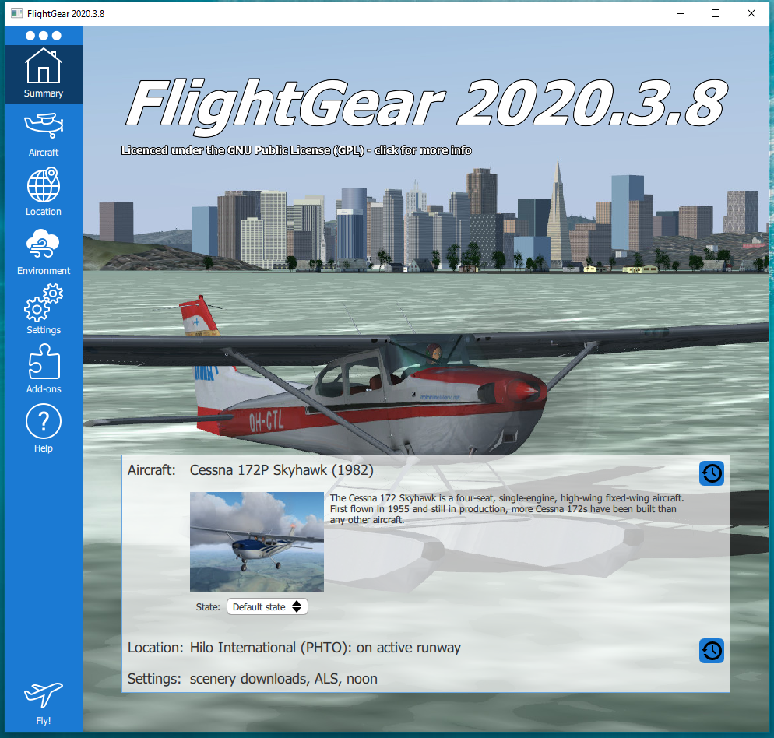
HOW TO USE:
Press "fly" in the flight gear . the app will inform you if you succeed to login in.
Enjoy!

Slide 21
DEMO 1:

Slide 22
DEMO:

